Slide 1
Trendy Threads
Lets shop man….

Slide 2
SUBMITTED BY:
Batch-4
Batchmates details
Y.Sowmya
Bhanusri
231FA04C20
231FA04B20
Farjana
Sakshi
231FA04D16
231FA04H01

Slide 3
Contents
1
2
Introduction
Website Features
Overview
Highlights
3
4
Website Pages
Advantages
Navigation
Benefits
5
6
Disadvantages
Conclusion
Challenges
Summary

Slide 4
INTRODUCTION:
Overview of Trendy Threads – Trendy Threads is an online fashion store designed to provide customers with stylish and quality clothing.
It is a B2C Ecommerce Model- Our platform follows the B2C (Business-to-Consumer) model, where businesses sell directly to individual customers. This model ensures an easy and seamless shopping experience with direct product access, secure payment gateways, and fast delivery services.
Purpose:To offer a seamless shopping experience for trendy apparel.Bringing a wide variety of fashion collections at affordable prices.Ensuring secure and convenient online purchase

Slide 5
WEBSITE FEATURES:
Easy navigation, intuitive layout for a smooth shopping experience.
User Friendly Interface
Users can save favorite products and review their cart before purchasing.
Wishlist & Cart
Customers can leave feedback to help others make informed decisions.
Customer Review
Fashion Blog
Latest trends & styling tips

Slide 6
WEBSITE PAGES:
Home: Showcases featured collections, trending items, and exclusive offers.
Shop: Includes various clothing categories, filtering options, and detailed product descriptions.
Blog: Provides fashion tips, latest trends, and interactive discussions.
About: Shares the brand’s mission, history, and values.
Contact: Allows customers to get in touch with customer service or submit inquiries.
Shopping Bag: Displays items added to the cart for purchase

Slide 7
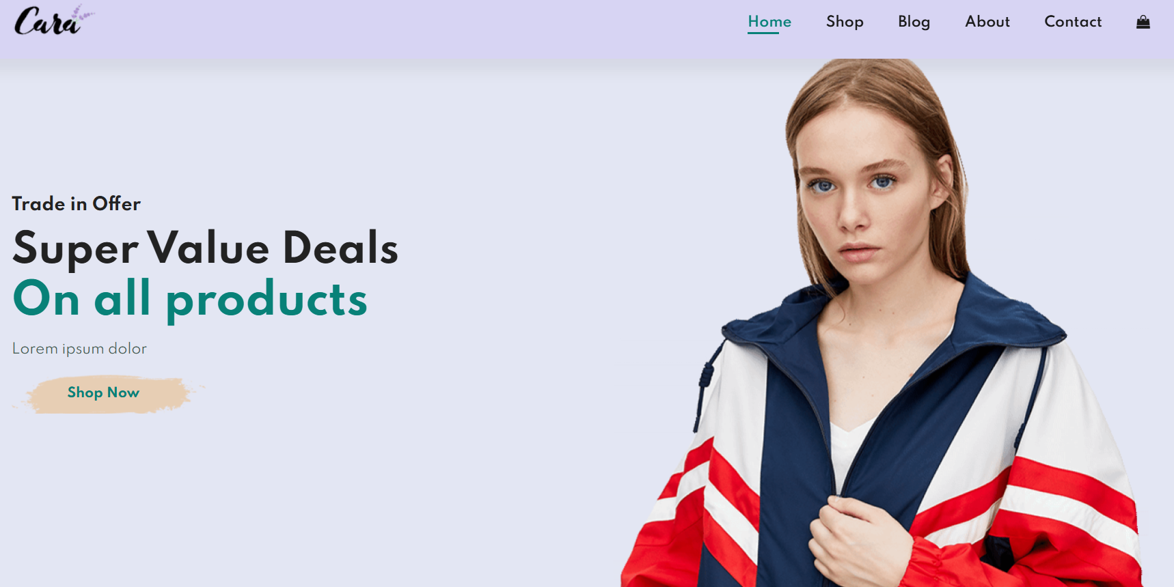
WEBSITE PAGES PICTURE:

Slide 8
HOME PAGE:
Engaging Banners:
Promotional slides for new arrivals, discounts, and
seasonal collections.
Featured Products:
Showcasing bestsellers, trending outfits, and
exclusive deals.
Navigation Bar with Icons:
Easy access to different pages like Home, Shop, Blog,
Wishlist, and Cart.

Slide 9
SHOP PAGE:
Product Categories:
Men’s, Women’s, and Kids’ clothing sections.
Filters for Easy Search:
Price range, brand, customer ratings, size, and color options.
Product Details:
High-quality images, descriptions, size guides, and customer reviews.
Add-to-Bag Option:
Seamless shopping experience with quick add-to-cart functionality.

Slide 10
SHOP PAGE:
Product Image
Cart
Product details of image.
Used to buy
Brand:
Size chart
What brand it is?
Size for users
Buy:
Wishlist
Buying Products
Through online payment
Liked by users

Slide 11
BLOG PAGE:
Fashion Articles: Trend-based content, styling tips, seasonal outfit suggestions.
Engaging Content: Blogs featuring celebrity fashion, DIY fashion hacks, and best-dressed lists.
User Interaction: Customers can comment, like, and share their favorite articles.
About & Contact Pages:
About Page:Brand history, mission, vision, and commitment to fashion.
Information about sustainability efforts and ethical sourcing.
Contact Page:Customer Support Details: Email, phone, and live chat support.
Inquiry Form: For feedback, complaints, or collaboration requests

Slide 12
Shopping Bag & Checkout:
Cart Icon with Item Count: Indicates the number of products added to the cart.
Checkout Process Overview: Step-by-step guide to complete a purchase.
Selecting items and quantities.
Entering shipping details.
Choosing payment method.
Order confirmation & tracking.
Secure Payment Options: Credit/debit cards, wallets, UPI, cash on delivery (if applicable).

Slide 13
Technologies Used:
1
HTML
2
CSS
Used to create the structure of web pages
Enhances styling, layout,
and responsiveness.
3
JAVASCRIPT
Adds interactivity such as filters, cart management, and form validation

Slide 14
ADVANTAGES:
Convenience: Shop anytime, anywhere. Variety: Large selection of products across categories. User Reviews: Customers can read feedback before purchasing.
Secure Payments: Multiple safe transaction options. Accessible Worldwide: Reach a global audience.

Slide 15
DISADVANTAGES:
No Try-Before-Buy: Customers can’t
physically test products.
Delivery Delays: Shipping times may vary. Online Fraud Risks: Potential security concerns. Customer Service Limitations: Delayed response times.
Internet Dependency: Requires a stable internet connection.

Slide 16
CONCLUSION:
Summary of Website Features: Recap of the website’s core functionalities and benefits.
Future Expansion:
Adding AI-powered recommendations and loyalty programs.
Expanding product categories beyond clothing (e.g., accessories, footwear).
Introducing AR-based virtual try-on for a better user experience.
Call to Action: "Join Trendy Threads Today! Start shopping for the latest trends now!"

Slide 17
